Slide 1
Standing for council Local Government Elections - October 2021

Slide 2
What is local government?
“Grass roots” level of government
Closest to the community
Local governments are established by the State Government to deliver services and facilities to communities.

Slide 3
Why stand for council?
Contribute to the development and well-being of your community
Empower a sense of purpose and commitment to your community

Slide 4
Role and responsibilities
Represent the interests of all electors, ratepayers and residents
Participate in council’s decision making process
Contribute to council’s strategic direction and planning with community input
Perform other functions as directed under the Local Government Act 1995.

Slide 5
Values and characteristics
Openness and transparency in decision making
Tolerance and respect in all relationships
Awareness of potential conflicts of interests
Fairness in promoting community issues (consider diverse interests and needs across the community and make decisions in the best interests of the district)
Observe principles of good governance and act with integrity

Slide 6
Essential skills of a councillor
Communicate, debate and actively participate in meetings
Enhance discussion and assist discussions to reach closure
Develop and maintain effective working relationships
Manage interpersonal conflicts
Exercise independent judgement

Slide 7
Commitment to the role
Attend all meetings
Listen to, and consider different points of view
Participate in the decision making process at meetings
Share the workload
Networking and community consultation
Participate in ‘on the job’ training and personal development opportunities

Slide 8
Decisions you might make as a councillor
Determining Policy
Planning for the future
Managing assets
Governing finances
Reviewing policy

Slide 9
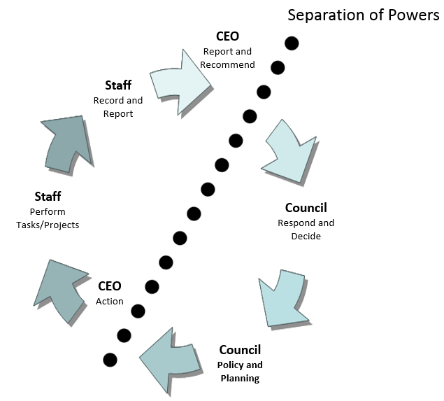
Local government decision making process

Slide 10
What to expect if you are elected
New councillors will need to:
Make a Declaration of Office
Complete universal training
Be briefed by the Mayor/President and/or CEO during an induction
Attend the first council meeting after election (this meeting usually introduces new council members and makes new appointments to various committees)

Slide 11
Support for candidates
Department’s website
Local Government Induction for Prospective Candidates
dlgsc.wa.gov.au/candidate-induction
Election information
dlgsc.wa.gov.au/elections
General support
dlgsc.wa.gov.au/support-and-advice
Other websites
Each local government has information about its own election
WA Electoral Commission for local government elections www.elections.wa.gov.au
For support provided by the WA Local Government Association (WALGA) www.walga.asn.au
WA local government legislation www.legislation.wa.gov.au/legislation/statutes.nsf/law_a465.html

Slide 12
Department of Local Government, Sport and Cultural Industries
Tel: +61 8 6552 7300
Free Call: 1800 634 541 (Country Only)
Email: lghotline@dlgsc.wa.gov.au
www.dlgsc.wa.gov.au

